Slide 1
The use of economics experiments to test conspiracy theories
Adrien Fillon
Erika Dömötör, Adrien Fillon, Kenzo Nera,
Zacharias Maniadis. (2025) Conspiracy Theories and Strategic Sophistication:
an Online Study

Slide 2

claims that the public is being pervasively lied to regarding some aspect of reality, to allow some group(s) to achieve a self-serving agenda. (Nera et al., 2023)
Notes:
Conspiracy Theories : “claims that the public is being pervasively lied to regarding some aspect of reality, to allow some group(s) to achieve a self-serving agenda”

Slide 3
Conspiracy Theories :
Strongly correlated with each others
(even if there is high heterogeneity)
Propencity to believe in conspiracy theories
- or even having a conspiracy mindset
By definition, related to manipulation and strategic thinking
Notes:
Conspiracy Theories propencity : “a continuum ranging from naïve trust in the canonical version of contemporary history to extremely paranoid conspiracy thinking.”

Slide 4
By definition, related to manipulation and strategic thinking
In economics: Strategic Sophistication
“The extent to which players’ behaviour reflects attempts to predict others’ decisions ”
Costa-Gomes, M., Crawford, V.P., Broseta, B. (2001). Cognition and behavior in
normal-form games: An experimental study. Econometrica, 69 (5), 1193-1235,
Retrieved from https://escholarship.org/uc/item/0fp8278k
Notes:
Conspiracy Theories propencity : “a continuum ranging from naïve trust in the canonical version of contemporary history to extremely paranoid conspiracy thinking.”

Slide 5
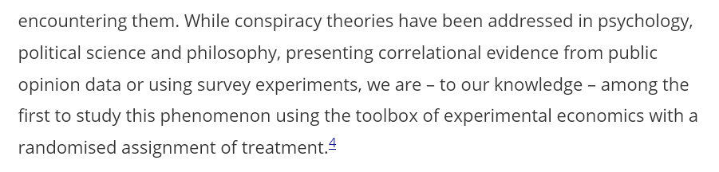
Balafoutas et al., 2021
Conspiracy Video
Control Video
Strategic Sophistication Game

Slide 6

Balafoutas et al., 2021
Conspiracy Video

Slide 7
Balafoutas et al., 2021
Conspiracy Video
Control Video
Strategic Sophistication Game
Notes:
There was a control video on a space shuttle

Slide 8
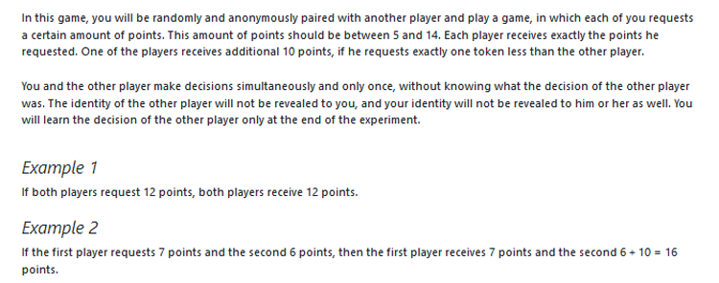
Balafoutas et al., 2021
Strategic Sophistication Game

Slide 9
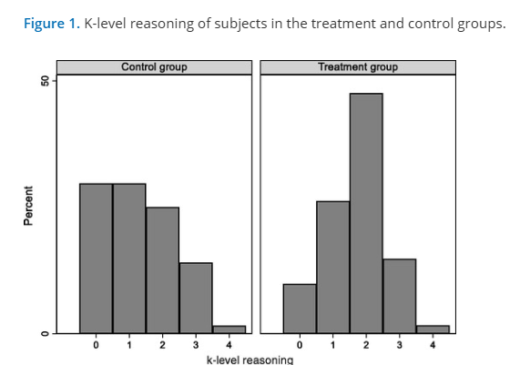
Results
subjects in the primed group exhibit on average higher levels of strategic sophistication than those in the control group (1.72 vs. 1.28, p < 0.05).

Slide 10
Goal of our research
Replication in an online sample
Explanation for the effect :
Conspiracy Mentality ?
Manipulativeness ?
A correlational and an experimental study

Slide 11
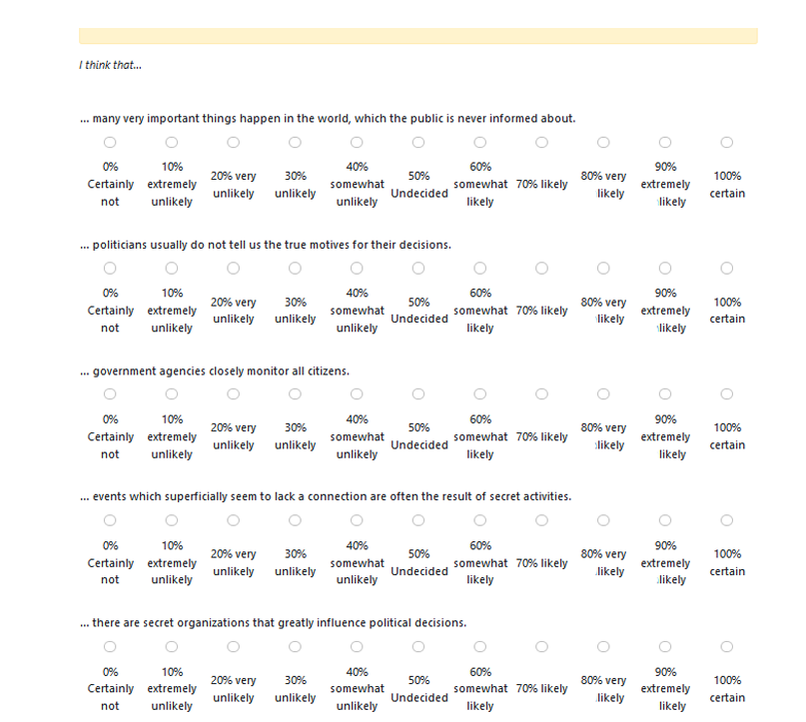
Correlational study
Conspiracy mindset
Strategic Sophistication Game
Strategic Sophistication Game
Conspiracy mindset

Slide 12
Results
Contrary to our main hypothesis, we did not find a significant correlation between conspiracy mentality and choice at the strategic sophistication game (i.e., level of strategic sophistication), r (95) = -0.04 [-0.24, 0.16], p = 0.69.
We then performed an exploratory test on the influence of the presentation order and found no difference for conspiracy mentality (t(92.92) = 1.35, p = 0.18, d = 0.27 [-0.13, 0.67]), and choices in the strategic game (t(94.95) = -0.14, p = 0.89, d = -0.03 [-0.43, 0.37]).

Slide 13
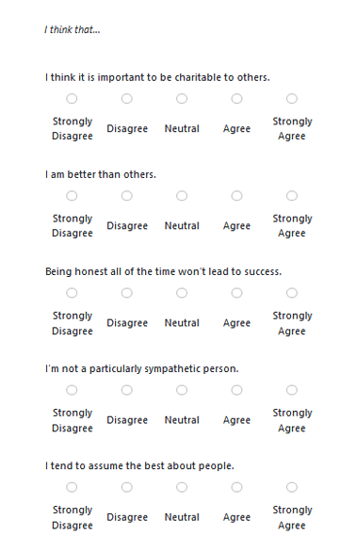
Experimental study
Conspiracy Video
Control Video
Strategic Sophistication Game
Manipulativeness
Conspiracy mindset

Slide 14
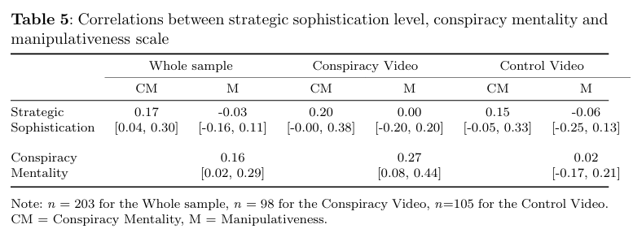
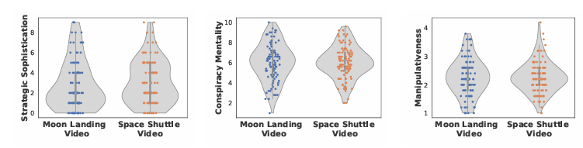
Results

Slide 15
Discussion
We have not replicated the effect of conspiracy ->strategic thinking
We have found a difference in the control group but treatment groups seem similar
We have no evidence for a link with conspiracy mindset or manipulativeness
Key differences :
Online experiment versus lab. Experiment :
Lack of understanding in filtering/recoding
Langage/culture (original : German ; replication : UK)
Problem with the money-request game (sensitive to risk-aversion)
Incentives (Higher in the original than in the replication)

